Slide 1
THE BARBADOS CHILDHOOD OBESITY PREVENTION COALITION
WHO WE ARE …
… AND WHAT WE’RE DOING

Slide 2
The main aim of the Coalition is to create a healthy school environment,
by galvanising support of the Ministries of Health and Education and the general public. HSFB is advocating for policy change, to restrict the sale and marketing of sugary drinks and unhealthy food in and around schools
in Barbados.
The Childhood Obesity Prevention Coalition
formed in 2019, is made up of a group of civil-society groups and individuals, including:
Faith-based Organisations
Sports Organisations
Youth Organisations
Parent Teacher Organisations
Individual members
It also includes youth members, technical specialists, policy influencers and concerned citizens.

Slide 3
The Barbados Childhood Obesity
Prevention Coalition

Slide 4
EFFECTIVE POLICY NEEDED
WORLD HEALTH ORGANISATION:
Childhood Obesity is one of the “most serious global challenges of the 21st century”.
By 2030, half of this region’s children are expected to be overweight or obese with all of its social and health implications.
2019 data shows Barbados’ school food environment continues to be
highly obesogenic and challenging for young people to navigate within the
context of “effective marketing strategies”.

Slide 5
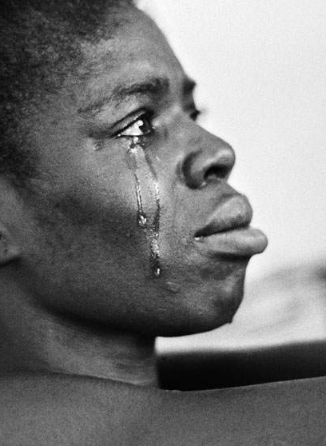
NCDs are killing us early!
Non-communicable diseases are now responsible for 8 out of every 10 deaths in Barbados, of which, 16% are premature.
31% of children in Barbados are
considered obese or overweight.
1 in 5 persons has diabetes.
Direct and indirect economic cost of NCDs in Barbados, is over Bds$209 mil annually

Slide 6
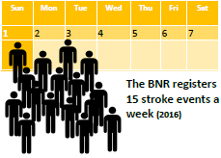
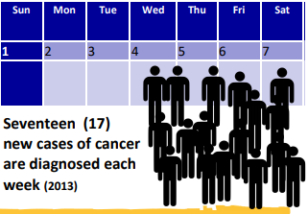
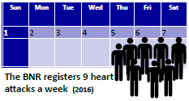
URGENT ATTENTION NEEDED
These facts are startling…
17 new cases of cancer a week (2013)
15 strokes a week (2016)
9 heart attacks a week (2016)
¹¹

Slide 7
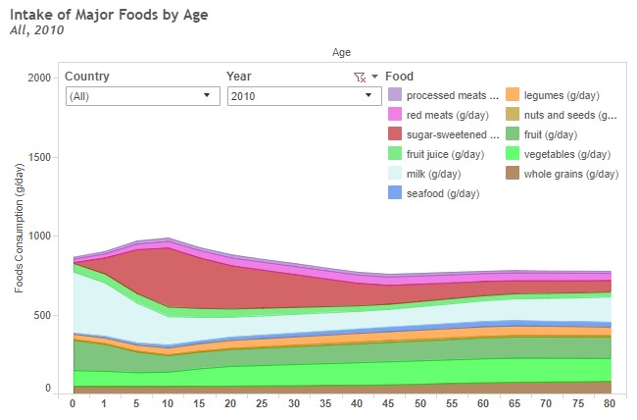
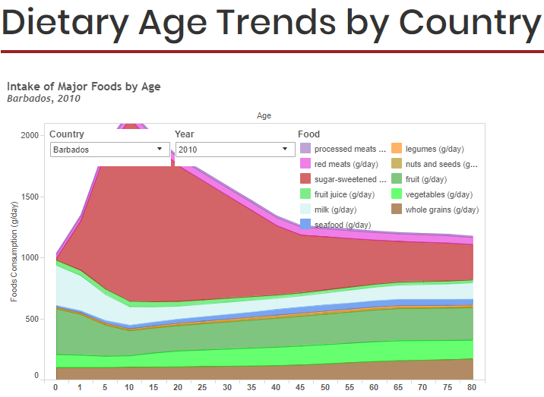
SUGAR INTAKE COMPARISON … Year highlighted 2010.
The portion represents sugary drinks intake
WORLDWIDE compared to BARBADOS
³
³

Slide 8
BARBADIANS ARE INTERESTED IN GETTING OUR CHILDREN HEALTHY
Barbados Childhood Obesity Prevention Public Opinion Poll 2018
How strongly would you support or oppose each of the following as part of a National guideline to create a healthy school food environment for kids?

Slide 10
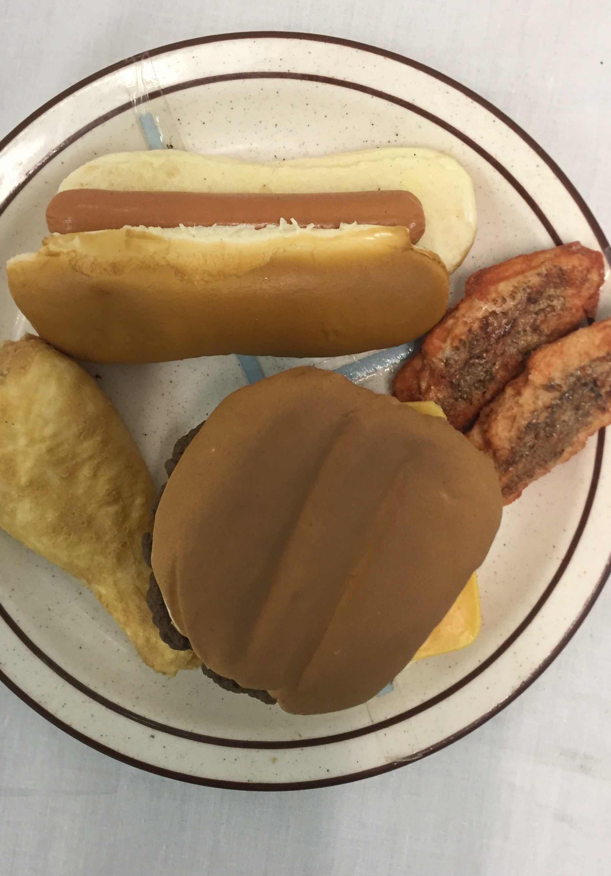
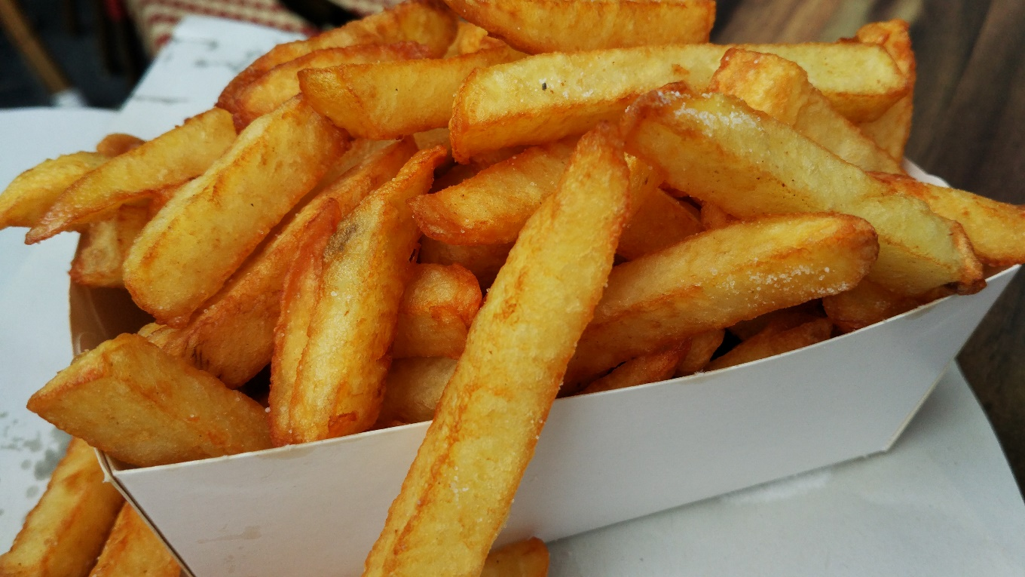
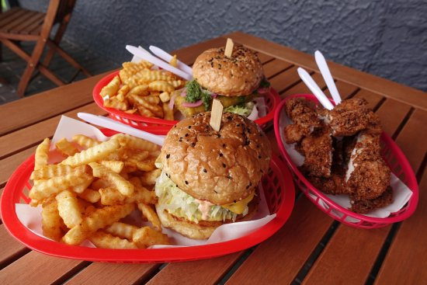
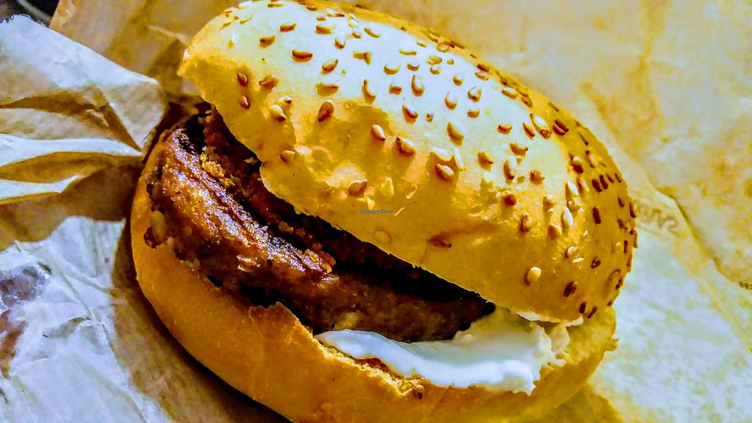
Barbados Student Population survey
(surveys carried out by
Healthy Caribbean Coalition)
18.5% ate fast food 3-4 times week
73.3% reported drinking 1 or more soft drinks a day
15% ate no vegetables or fruit in the past month
WE NEED TO CHANGE THE WAY WE FEED OUR CHILDREN

Slide 11
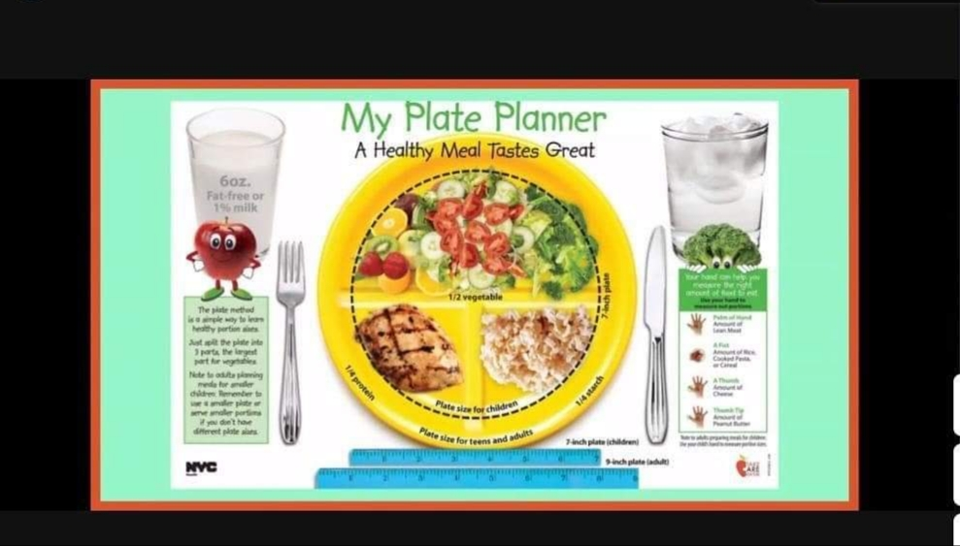
For more information on the
Childhood Obesity Prevention Campaign log on to our social media pages:
Facebook: @ Heart & Stroke Foundation of Barbados
Instagram & Twitter:
@ hsfbarbados
ATTENTION SCHOOLS
If your school or PTA would like to hear more or learn about the movement towards creating a healthier school environment…
send us an emai… advocacyofficer@hsfbarbados.com

Slide 12
ACT NOW!
#OuttaMySchool
#SwitchItUp246

